Slide 1
Localization Accessibility
Sindura and Jonny

Slide 2
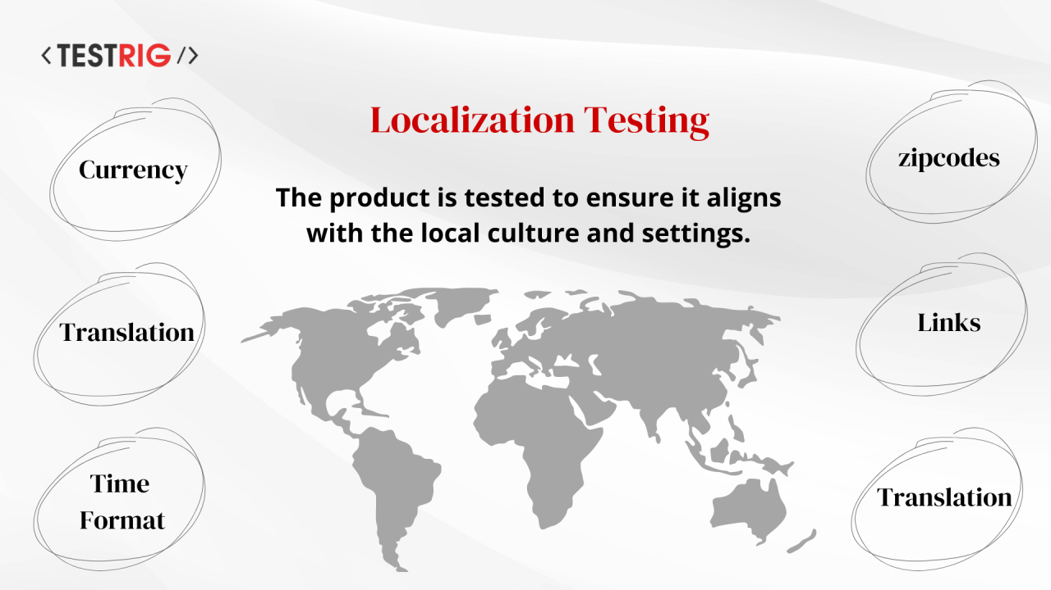
localization testing (L10N)
Notes:
a non-functional software testing technique that verifies whether an application is properly adapted for a specific target region, country, culture, or locale

Slide 3
localization testing (L10N)
Process of making a product ready for the global market
Launching a product in multiple countries with region-specific marketing, compliance, and support strategies
Localization testing typically focuses on four core areas:
Language
Culture
Regional standards
Legal and regulatory compliance
Notes:
This includes your terminology, tone, placeholder substitution, and font rendering.
Checks that images used, emojis, color choices, and layout direction align with local expectations and sensitivities.
Ensures that your formats for data and time, currencies, number systems, measurement units, phone formats, and time zones align with local expectations.
Before rolling out, the product must meet local data privacy, tax, content, and product restrictions.

Slide 4
Localization Test Cases
Verify that text does not overflow or clip outside of button boundaries when translated into longer-character languages (e.g., German).
Confirm that reading-direction shifts correctly for Right-to-Left (RTL) languages like Arabic or Hebrew.
Check that payment flows display regional currency formatting correctly (e.g., $1,000.50 in the US vs. 1.000,50 € in Germany).
Ensure calendar components match regional defaults, such as Sunday vs. Monday as the first day of the week.
Validate that error alerts and toast notifications are completely translated rather than falling back to default source code strings.

Slide 5
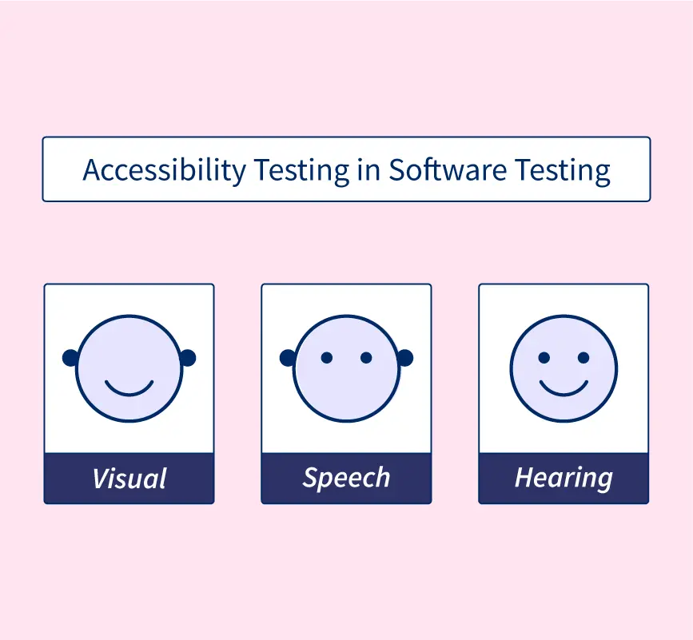
accessibility (A11y) testing

Slide 6
accessibility (A11y) testing
Ensure universal access for users with disabilities.
Users with visual, motor, auditory, or cognitive impairments.
Accessibility testing typically focuses on four core areas:
WCAG Compliance
POUR Principles
Notes:
Ensures people with visual, hearing, motor, or cognitive disabilities can access and use digital services equally.
Clear navigation, structured content, and readable text improve usability for all users—not just those with disabilities.
Around 15% of the global population lives with some form of disability. Accessibility expands your user base and market reach.
Evaluation against the W3C Web Content Accessibility Guidelines spanning levels A, AA, and AAA.
Perceivable, Operable, Understandable, and Robust.

Slide 7
Accessibility Test Cases
Visual Elements (Color Contrast Testing)
Navigation Flow
Auditory Aids
Screen Reader Integrity
Keyboard Accessibility
Notes:
Reviewing color contrast ratio, text scalability, and mandatory image alt text.
Validating complete tab-order flow without trapped mouse cursor prerequisites.
Confirming video transcripts and time-synchronized close captioning files.
Auditing Aria-labels for tool compatibility like JAWS Screen Reader or NVDA Screen Reader.

Slide 8
Accessibility Testing Tools
Automated Browser Extensions
WAVE
axe DevTools
Built-In & Guided Auditing
Lighthouse (Google Chrome)
Accessibility Insights for Web
Screen Readers for Manual Testing
NVDA (NonVisual Desktop Access)
VoiceOver
JAWS
Notes:
highly accurate automated scans
Built directly into Chrome DevTools.... Accessibility Insights for Web. Created by Microsoft
NVDA -free, open-source screen reader for Windows.
Voiceover macOS and iOS devices.
Jaws A highly popular commercial screen reader.

